Slide 1

Click the menu for instructions & tutorials
Instructions
Set Up A Screen
Create a Player
Create Movement
Collision Detection
Creating Levels
Adding Sound / Music
Scores & Saving
Progress & Marks

Slide 2
Click the logo ⬇ to navigate
to the main menu:
Instructions
Click these buttons ⬇ to navigate through the sections :
Instructions
1
2
3
4
5
6
7
Marks
You have been contacted by XY Games with a project to complete for them. Their client wants you to design a new computer game for them to launch for ages 10 – 14 year olds. They have written a brief requirements specification which XY Games wants you to follow along with some ideas of your own.
To help you along the way, XY Games have provided you with some tutorials to get you started with some of the main aspects of the game.
As their client is offering a great deal of money for the game, they would like you to provide updates of your progress in the form of a 1 page report & video of the game working each week. This should be stored in your ‘Computer Science’ folder for them to copy & send to the client. You will receive client feedback each week.
To help you with your report, a template has been provided.
Click this button to move through this section:

Slide 3
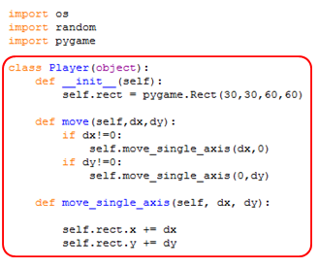
Click the logo ⬇ to navigate
to the main menu:
Instructions
Click these buttons ⬇ to navigate through the sections :
Instructions
1
2
3
4
5
6
7
Marks
The tutorials in this presentation should be viewed in order – where code has been added code already seen in a previous section a red box highlights the new / changed code.
Don’t forget to save your code regularly (every few minutes) and save each section as a new version by selecting File → Save As, then using MyGame_v1.py, MyGame_v2.py….
Additional Resources:
The Official PyGame e-Book
Program Arcade Games Website
Click these buttons to navigate within sections :

Slide 4
Client Requirements
Instructions
1
2
3
4
5
6
7
Marks
Must
Be written in PyGame
Be a Platform Game
Should
Have 2 or more levels
Allow users to save high scores
Could
Output a leaderboard from previous players
Include music
Won’t
Be web based
Allow keyboard input for movement (WASD / arrows)
Include images / spites
Allow player to move out of screen
Include errors that don’t have a user friendly message
Include collision detection
Include sounds
Use copyright material
Click this button to move back through this section:

Slide 5
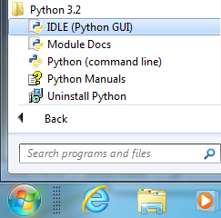
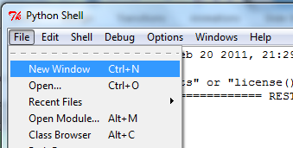
Setting Up a Game Screen
Instructions
1
2
3
4
5
6
7
Marks
Start creating your PyGame game by opening up Python 3.2 IDLE
(don’t open 3.4 by mistake as this doesn’t have PyGame installed!)
Now click File → New Window to create a new python program.
Save this as MyGame_v1.py
The v1 in the name means ‘version 1’ which will allow you to create a new version for each save. This means if you make a mistake, you can always roll back!

Slide 6

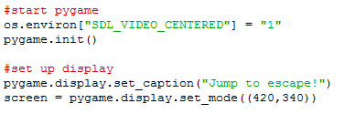
Setting Up a Game Screen
Instructions
1
2
3
4
5
6
7
Marks
In your new program, import the library files that you need to start your game. Don’t forget to add comments to explain what these do.
Add this code to your program.
pygame.init() initialises the pygame code hidden in the import above.
Don’t forget to change the display to the size & name you want to give your game!

Slide 7
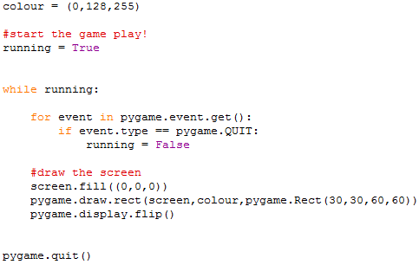
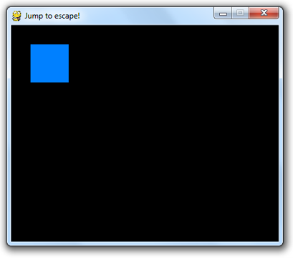
Setting Up a Game Screen
Instructions
1
2
3
4
5
6
7
Marks
Finally, create the main part of your program which will loop until your user presses quit.

Slide 8

Setting Up a Game Screen
Instructions
1
2
3
4
5
6
7
Marks
Here’s a few hints on how to customise the code ☺
Change this line to adjust the screen colour (it’s in RGB)
Change this line to adjust the colour of the rectangle
Change the green text to change the title that appears on the game window:
Change this line to adjust the size of the game window (width,height)

Slide 9


Setting Up a Player
Instructions
1
2
3
4
5
6
7
Marks
Before we jump into the code, it is worth understanding that we are using a style of code called Object Oriented. This is an efficient way of coding when objects such as enemies, walls, or pickups appear more than one (you only need to code them once!)
Class
Object
A class is like a blueprint of an object. Here, a class of cat tells us that a cat has a colour, number of ears, a name etc.
All of this describes a cat.
An object is real. In this case, my cat’s name is Greebo, he has grey fur, and two ears. He is a ‘real’ instance of a cat which was the class.

Slide 10
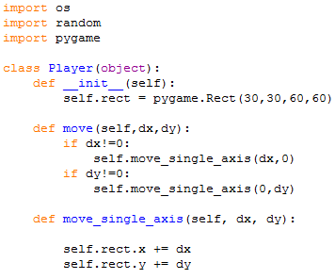
Setting Up a Player
Instructions
1
2
3
4
5
6
7
Marks
You should already have coded your imports at the start of your program (if not, click on tutorial 1 above).
Under this, create your player class. In here, you will code the three procedures that create & move the rectangle.

Slide 11
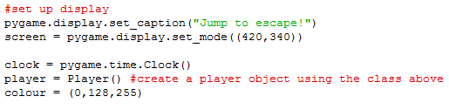


Setting Up a Player
Instructions
1
2
3
4
5
6
7
Marks
Just like a procedure or function, even though we have added the code, nothing will happen until we have called it. For a class, nothing happens to the description, until you create the object.
The clock works a little bit like time.sleep() in regular Python code.

Slide 12
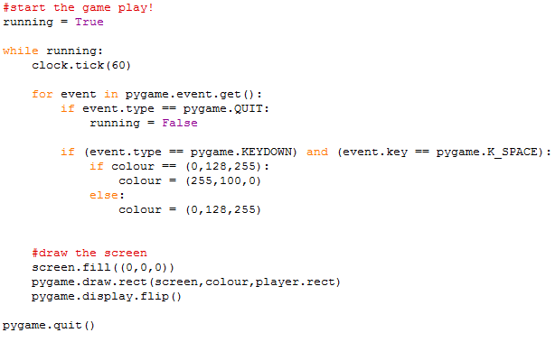
Setting Up a Player
Instructions
1
2
3
4
5
6
7
Marks
What has changed in the main program?
We’ve added a 1 second pause
We’ve added another IF statement to do something when we press SPACE
We’ve changed the rectangle into our Player class
Don’t forget to save this as a new version in case you make a mistake!
Eg. MyGame_v2.py

Slide 13
Setting Up a Player
Instructions
1
2
3
4
5
6
7
Marks
The code above is enough to create the basic code for a rectangle with a solid colour to appear on your screen (click on tutorial 3 to make your player move!), but what if you want to go further?
Would you like to use a different shape?
For more on drawing your own shapes, you can follow this link
Would you like to use an image instead of a shape?
Click next ☺

Slide 14


Setting Up a Player
Instructions
1
2
3
4
5
6
7
Marks
The code we will use to create image sprites is similar to the shape, but we need to create the image & save it to the same folder as our python code first.
Actual size of image used!
You can choose to adjust your player class here, or create a new player_sprite class.
Don’t forget to save this as a new version in case you make a mistake!
Eg. MyGame_v3.py

Slide 15
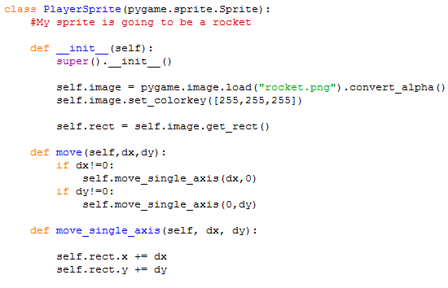
Setting Up a Player
Instructions
1
2
3
4
5
6
7
Marks
The only code that has changed here is the class type & the __init__() procedure which brings in an image instead of drawing a shape.

Slide 16

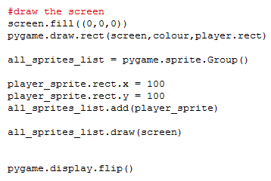
Setting Up a Player
Instructions
1
2
3
4
5
6
7
Marks
The image object can be created in the same way as before.
Drawing the object on screen requires us to:
create a Sprite Group
set the co-ordinates (place on the screen)
add the sprite to the Group
then draw all sprites in the Group.
Phew!

Slide 17
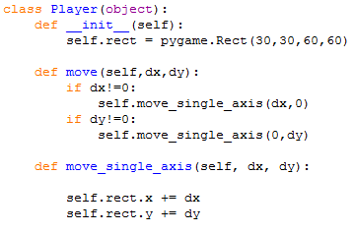
Moving The Player
Instructions
1
2
3
4
5
6
7
Marks
When we created the Player class, we actually set up all of the procedures needed to move our player rectangle, but we didn’t call them in the main program.
Let’s do that now!

Slide 18
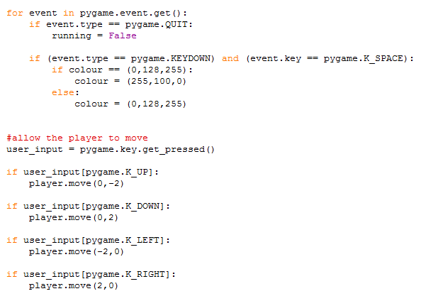
Moving The Player
Instructions
1
2
3
4
5
6
7
Marks
Underneath the FOR loop that took in the key presses, we are going to create four IF statements that call the move() procedure for the player & change its position.
Note: You don’t have to use the arrows. Click here for alternative key presses

Slide 19

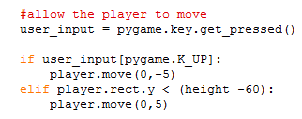
Falling & Jumping
Instructions
1
2
3
4
5
6
7
Marks
For a real platformer, you need to have some basic physics in your game & this is usually seen in the form of falling.
The first thing we are going to do is set the width & height of the game screen as variables (before we just used hard coded numbers)
Next, we need to add an ELSE IF to the UP key press that moves the rectangle down if it’s not on the bottom of the screen.

Slide 20
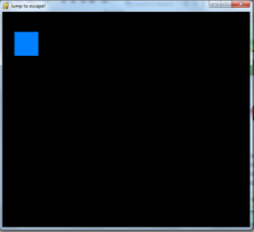
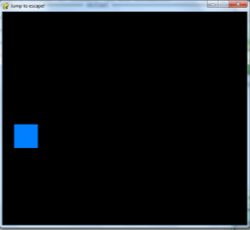
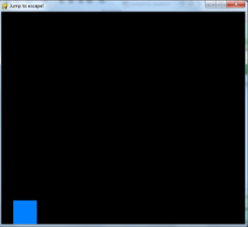

Falling & Jumping
Instructions
1
2
3
4
5
6
7
Marks
You now have a rectangle that appears near the top left of the screen and then falls to the floor. In other words, you have created gravity in your game world!

Slide 21
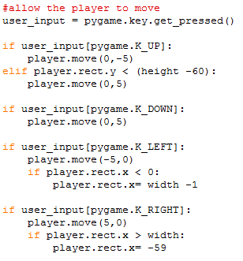
Falling & Jumping
Instructions
1
2
3
4
5
6
7
Marks
The final part is to prevent the player from disappearing from the edges of the screen.
The code seen here will allow your player to jump out one side of the screen and appear on the other.
You may want to adjust this to make the edge of the screen a barrier.

Slide 22

Creating Scenery
Instructions
1
2
3
4
5
6
7
Marks
Objects to be avoided can be anything you want in a game, but are usually walls, or platforms in this style of game.
Here, we are going to create a list of walls in our game with each one being a square on the screen in a set pattern.
To do this, we need to create a new class to describe what a wall is (a rectangle) and what it does (nothing!).

Slide 23
Creating Scenery
Instructions
1
2
3
4
5
6
7
Marks
Objects to be avoided can be anything you want in a game, but are usually walls, or platforms in this style of game.
Here, we are going to create a list of walls in our game with each one being a square on the screen in a set pattern.
To do this, we need to create a new class to describe what a wall is (a rectangle) and what it does (nothing!).

Slide 24
Creating Scenery
Instructions
1
2
3
4
5
6
7
Marks
Objects to be avoided can be anything you want in a game, but are usually walls, or platforms in this style of game.
Here, we are going to create a list of walls in our game with each one being a square on the screen in a set pattern.
To do this, we need to create a new class to describe what a wall is (a rectangle) and what it does (nothing!).

Slide 25
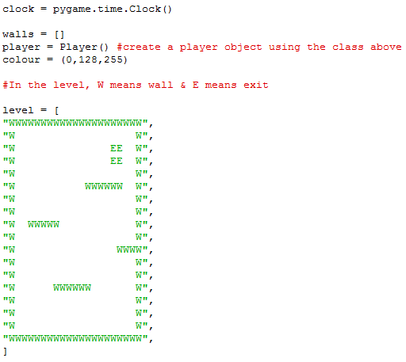
Creating Scenery
Instructions
1
2
3
4
5
6
7
Marks
Because we need more than one wall, we can save these in a list (also known as an array).
Here, we are using two lists:
level [ ] is a list of strings for each row in a level (the comma separates each row)
Later, we will create more levels
walls [ ] is a list of levels, so a list of lists!

Slide 26
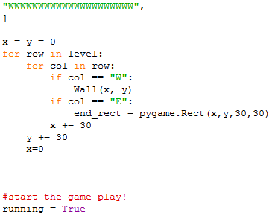
Creating Scenery
Instructions
1
2
3
4
5
6
7
Marks
After creating the level, we need to read the letters into the program & create the Wall objects.
Here, we are using a loop inside a loop, called a nested loop.
Inner loop looks at each letter
Outer loop looks at each row

Slide 27
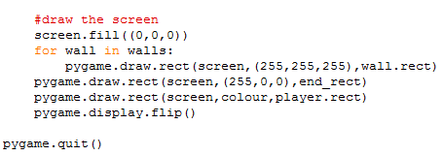
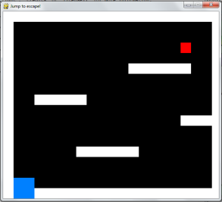
Creating Scenery
Instructions
1
2
3
4
5
6
7
Marks
The final part needed for showing scenery on the screen is at the end of the program where we draw our objects onto the screen.
Note that we have used another loop here because there is more than one wall.
We now have scenery, but something is missing…
Don’t forget to save this as a new version in case you make a mistake! Eg. MyGame_v3.py

Slide 28
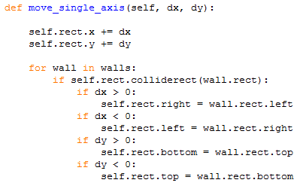
Creating Scenery
Instructions
1
2
3
4
5
6
7
Marks
Collision detection is the name given for adding programming that listens for when an object is touching another object.
In the move_single_axis() procedure we have already created for the player, we need to add IF statements for each wall – Again, we have used a loop because we have more than one wall.

Slide 29
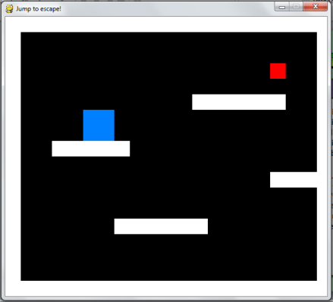
Creating Scenery
Instructions
1
2
3
4
5
6
7
Marks
In our program with walls, this allows the player to jump using the physics we created in tutorial 3, and land on the walls that we created without falling any further.
How else could we use this?
Enemies could be placed on the screen
Health ‘pickups’ could be added
Mazes could be created
Walls could be ‘don’t touch’

Slide 30
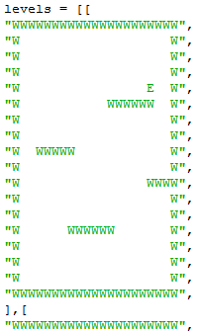
Creating Random Levels
Instructions
1
2
3
4
5
6
7
Marks
We have already set up the foundation of having more than one level by creating the list called level.
Next, we need to create a new list called levels that holds all of the levels that could be played. In python, this is called a matrix, but for now all we need to remember is that we have used extra square brackets to separate each level.
Add this into your program under the level [ ] list.

Slide 31
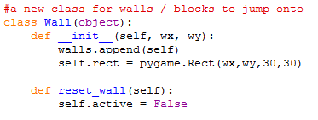

Creating Random Levels
Instructions
1
2
3
4
5
6
7
Marks
If we want to change the wall objects on the screen, we need to clear what was there before. The easiest way to do this is to create a procedure which destroys the previous objects.
If we don’t destroy the old objects first, the new objects will appear over the top of the old ones.

Slide 32
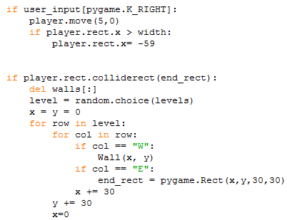
Creating Random Levels
Instructions
1
2
3
4
5
6
7
Marks
In the main program, underneath the player move statements we now need to add an extra IF statement that deletes the old walls, then reads in the new level. (where have we seen this loop before?)
An extra feature is added here which selects a random level from the list instead of just moving up one!

Slide 33

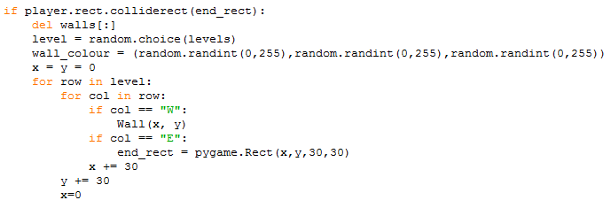
Creating Coloured Levels
Instructions
1
2
3
4
5
6
7
Marks
The wall colour is set up as white to start with.
Next, we need to create a random colour for the walls (why have we used 255 for the colour?)

Slide 34
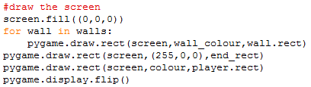
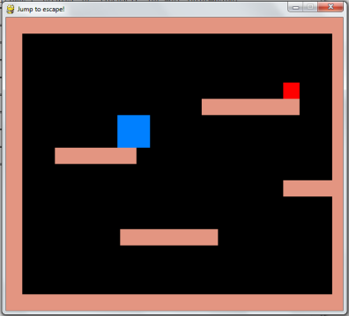
Creating Coloured Levels
Instructions
1
2
3
4
5
6
7
Marks
Finally, we need up update the drawing section at the end of the program to pass in the colour variable instead of a set colour.
The colour of the walls is now randomly generated using the RGB (Red, Green, Blue) colour values.

Slide 35
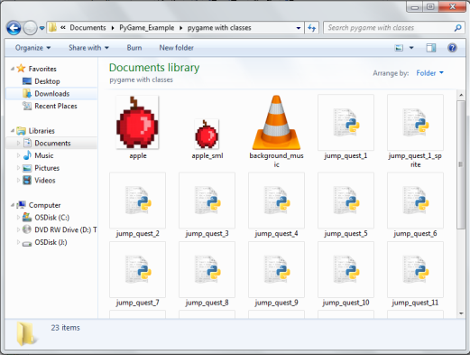
Adding Sounds & Music
Instructions
1
2
3
4
5
6
7
Marks
PyGame allows you to add both music and sounds by saving .mp3 files into your PyGame code folder.
If you intend to use lots of sound files, it may be useful to save them into a ‘sound’ folder in the code folder. Instead of just using the file name, you will need to also add the folder name.
Make sure that you are using royalty free music such as Creative Commons from Bensound
load("background_music.mp3")
load(“sound/background_music.mp3")

Slide 36
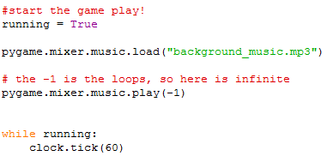
Adding Sounds & Music
Instructions
1
2
3
4
5
6
7
Marks
You can add a PyGame music player at any point in your game, but to play music it is added at the start of the main program.
Parameter | Means
-1 | Loops sound forever
1 | Plays the sound once
2 | Plays the sound twice
x | Plays the sound for the value of x

Slide 37
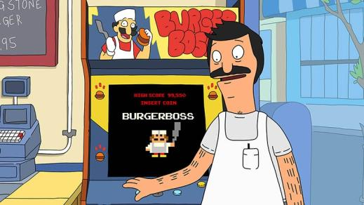
Saving Game Data
Instructions
1
2
3
4
5
6
7
Marks
There are a number of ways to save progress in games. When looking at Retro arcade style games, these saves were in the form of High Scores which allowed the player to enter their name into the ‘Hall of Fame’.
This section will take us through how to save high scores into a text file and use them as part of our game.

Slide 38
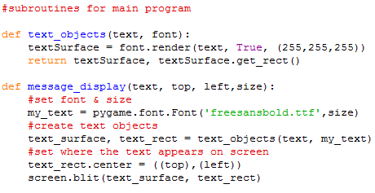
Outputting Text
Instructions
1
2
3
4
5
6
7
Marks
The first part of game scores is the ability to output text to the screen. Unlike using the print() function, in PyGame this is a little more complex.
We will start off by creating two new sub-routines underneath the wall class

Slide 39


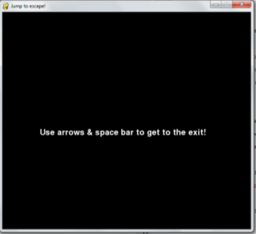
Outputting Text
Instructions
1
2
3
4
5
6
7
Marks
To allow us to pause whilst the player reads the text, we need to add the time import to the top of the code.
Then, near the start of the main program (usually just after we start the game music) add in the code to display the game instructions.

Slide 40

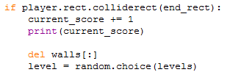
Creating a Score
Instructions
1
2
3
4
5
6
7
Marks
The current_score variable is created at the top of the code and given an initial value of 0.
Then inside the code for player movement, we increment the current_score variable each time the game detects that the player touches the exit.
The print() here just outputs the score to the Shell as a test

Slide 41
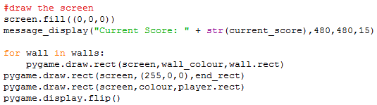
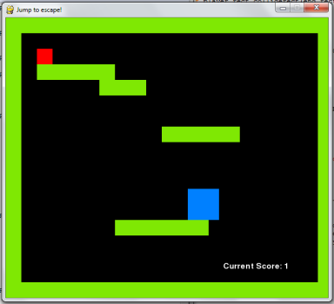
Creating a Score
Instructions
1
2
3
4
5
6
7
Marks
Just like we did with the instructions, we can use the message_display() procedure to output the current score.
Each time we reach the red exit square we should see the current score shown on the screen increase.

Slide 42
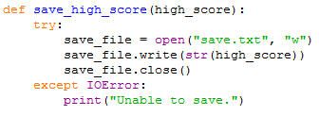

Saving a Score
Instructions
1
2
3
4
5
6
7
Marks
Now we have a current score, we can use a text file to remember the highest score so far.
To do this, we need to create two new sub-routines underneath our message_display() procedure.
The first of these will save our high score to a text file.
Try-Catch statements let us run code that may error.
First it tries to run the code we want, then if an error occurs it allows us to stop the program crashing.
This is called ‘error handling’

Slide 43
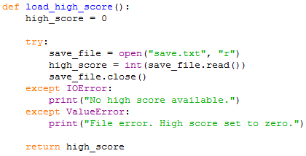
Saving a Score
Instructions
1
2
3
4
5
6
7
Marks
The second sub-routine is reading the high score from the text file & loading it into the program.
This is a function because it returns a value (procedures do not).
Look! Here we can catch two types of error,
An IO Error handles errors where the data can’t be found.
A Value Error handles errors here the file can’t be read, or the data type is wrong.

Slide 44
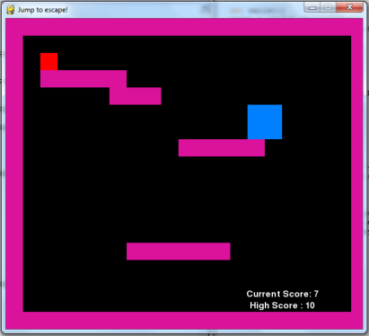

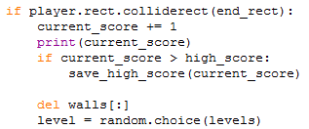
Saving a Score
Instructions
1
2
3
4
5
6
7
Marks
At the start of the main program loop, we create the high_score variable with the value passed back by the load_high_score() function.
Once we have the ability to save a high score, we need to know when to update the score.
Here, an IF statement calls the save_high_score() procedure once the current score goes beyond the high score. Look at your text file to check!

Slide 45

Saving a Score
Instructions
1
2
3
4
5
6
7
Marks
Finally, we need to add the final line which outputs the High Score under the Current Score:
Both scores should now appear at the bottom right of the game screen and update as you move through the game.
But is this enough for a leaderboard?
Nearly…

Slide 46
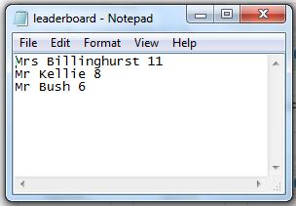
Leaderboards - Extension
Instructions
1
2
3
4
5
6
7
Marks
Leaderboards in PyGame require us to understand the logic behind how data is saved both physically & logically in our program. This section is here to challenge you!
The first thing we are going to do is create a text file containing three names and their scores (you may need to create this in WordPad if the network prevents you from using NotePad)
Don’t forget to save & close your file.
If you open a file, just like a cupboard you can’t open it again without closing it first!

Slide 47


Leaderboards - Extension
Instructions
1
2
3
4
5
6
7
Marks
Next we are going to extend our imports to include re
This allows us to use a function which finds the numbers in a string.
Clever huh?
Underneath the imports we are going to create a special type of variable called a global variable. Leaderboard is also going to be a list (array).
Global variables can be seen & used anywhere in the code, including inside sub-routines.

Slide 48
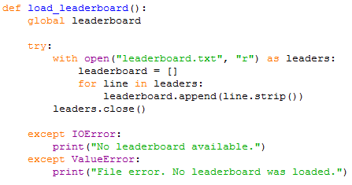
Leaderboards - Extension
Instructions
1
2
3
4
5
6
7
Marks
Just like we did for loading & saving the simple high score, we are going to create two new sub-routines for loading and saving our leaderboard.
Unlike the simple read from before, this procedure reads each line from the file and saves it into a new item in the array.
This way, each leader has their own item.

Slide 49
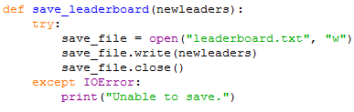
Leaderboards - Extension
Instructions
1
2
3
4
5
6
7
Marks
Thankfully, our save procedure is almost identical to the high score procedure.
The only difference here is that we have passed in a string instead of a number .
Why use sub-routines?
Programmers use sub-routines (functions & procedures) to make their code more efficient. It allows you to use the code more than once with different values. Put simply: “Genius through the pursuit of laziness”

Slide 50
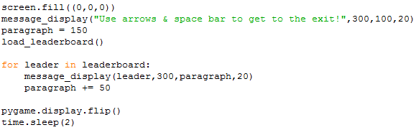
Leaderboards - Extension
Instructions
1
2
3
4
5
6
7
Marks
To display the current leaderboard at the start of the game, we can adjust the code to include a call to the load_leaderboard() procedure and then a loop through each leader in the list.
How else could we use this?
I have chosen to display my high scorers at the start of the game. Perhaps you could display yours at the end, as a scrolling list going up the screen, or as names flashing up one by one?

Slide 51
Leaderboards - Extension
Instructions
1
2
3
4
5
6
7
Marks
Updating the leaderboard requires us to look at the logic of a leaderboard. Let’s use this flowchart to help:
START
END
Is score > highest leader?
Is score > 2nd highest leader?
Is score > 3rd highest leader?
No
No
No
Yes
Yes
Yes
INPUT name
INPUT name
INPUT name
Highest leader =
name + score
2nd Highest leader = name + score
3rd Highest leader = name + score

Slide 52
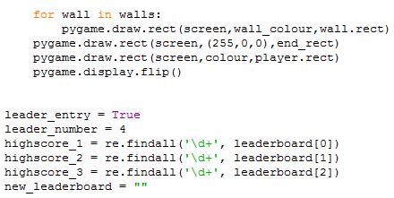
Leaderboards - Extension
Instructions
1
2
3
4
5
6
7
Marks
Although we have been updating the current score throughout the main game loop, writing into the leaderboard happens at the end of the game & after the main game loop. Here, we need to set up the extra variables needed for writing into the correct place.
Remember importing re?
This is where we use it to extract the number (score) from the leaderboard

Slide 53
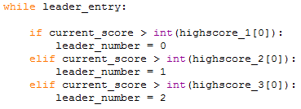
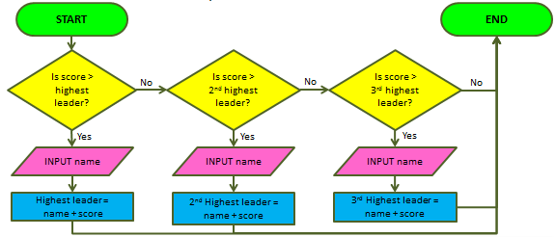
Leaderboards - Extension
Instructions
1
2
3
4
5
6
7
Marks
We set up leader_entry to allow us to loop the output to the screen until our user has finished entering their name.
Using our flowchart logic, we then need to check if our current score is higher than either the 1st, 2nd, or 3rd highest scorer.
leader_number will tell the code where to write the high score in the list (4 means don’t write it at all!)

Slide 54
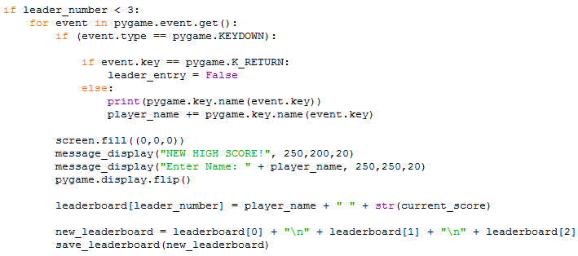
Leaderboards - Extension
Instructions
1
2
3
4
5
6
7
Marks
Next we run the save game code IF the player needs to feature in the leaderboard.
Each keyboard press is recorded & output to the screen until the player presses ENTER. Then the save_leaderboard() procedure is called.

Slide 55



Leaderboards - Extension
Instructions
1
2
3
4
5
6
7
Marks
Finally, an ELSE statement is used to allow a simple ‘Game Over’ to display before the game quits if the player didn’t make it to the leaderboard.
Run the game again, or open your text file to check if the leaders names & scores have been updated!

Slide 56
Marking Checklist
Instructions
1
2
3
4
5
6
7
Marks
Task | Complete | Comments
Create PyGame Game screen with background colour & title
Create a player class & object which moved using keyboard input
Create physics which makes an object fall (or fly)
Create collision detection for game screen edges
Create lists of objects on the game screen
Create collision detection with other objects
Create multiple levels in the game
Add sounds / music to the game
Allow user to save progress onto a Leaderboard

Slide 57
Name:
Class:
Progress Update: [Date Here]
This week I have….
I tested this by…
Next week I plan to…
Snippets of my updated code:
My video for this week is called:

